Slide 1
100 Years of College Football
Which Conference is the Best?

Slide 2
Overview
Many have proposed various methods for declaring what FBS College Football conference is "The Strongest Conference". Some could cite the number of National Championships, Bowl games, highest ratings, game attendance, or even revenue.
This analysis seeks to see the trends (season-to-season for the last 100 years) of conference strength defined as the non-conference win percentage for that conference.

Slide 3
Definition of College Football Conferences
College football teams organize themselves into groups called “conferences.” These will typically consist of 16-18 teams that will each play most of their 12-13 game season against each other. However, each team plays 4-5 games outside their conference allowing a comparison between conferences. If one conference loses frequently, that can be evidence demonstrating they are not as good.
Their are typically three groups of conferences as outlined below:
Power 5 (Perceived to be the best) | Group of 5 | Other
Atlantic Coast Conference (ACC) | American Athletic Conference (AAC) | FEB Independents (not formally affiliated with any conference or each other)
Big 10 | Conference USA (CUSA)
Big 12 | Mid-American (MAC)
Pacific-12 (PAC-12) | Mountain West (MWC)
Southeastern Conference (SEC) | Sun Belt Conference (SBC)

Slide 4
Methodology
Data from https://collegefootballdata.com
I pulled data from 1923 and on, but could have gone back further.
Vacated wins are not vacated in this analysis.
Ties counted as a half-win.
I considered defunct conferences for the calculation of non-conference wins.
I tried to capture when conferences re-branded vs. collapsed. For example, when the PAC 10 became the PAC 12, I considered that the same conference (SEC did not re-brand when they added schools!). However, the exact ones to choose are up for debate.
This approach follows the brand of a conference over time.

Slide 5
Interesting Findings
Under these metrics, there is weight to the argument that the SEC is the best conference in college football.
  Their non-conference win percentage was the highest in average and median over their existence. The variance of the win percentage was small as well.
The American Athletic Conference has performed more like a Power 5 conference, although their success has fallen in recent years.
The Sun Belt, appears to be a rising star within the Group of 5.
Today's Power 5 Conferences have been steadily growing in strength starting in the 1950's-70's (depending on the conference), but seem to have plateaued over the last 10 years.
Today's Power 5 Conferences are playing each other proportionally more than in previous years.
Independents have been holding at about a 50% win-rate for the last 100 years. This differs from the patterns from the other conferences.

Slide 6
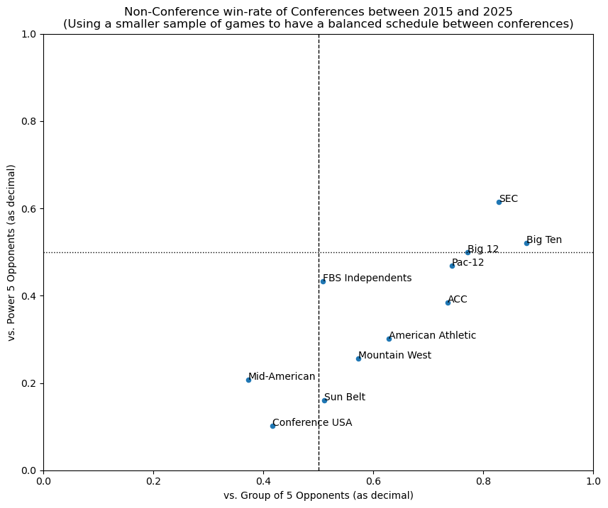
Win Rates Over Last 10 Years
Key Takeaways
Not surprisingly, there appears to be a strong positive correlation between winning against Power 5 opponents and winning against Group of 5 opponents.
SEC seems to be the best followed closely by the Big Ten.
The ACC is the worst of the Power 5.
There may be 3 clusters of Conferences instead of just Power 5 and Group of 5.

Slide 7
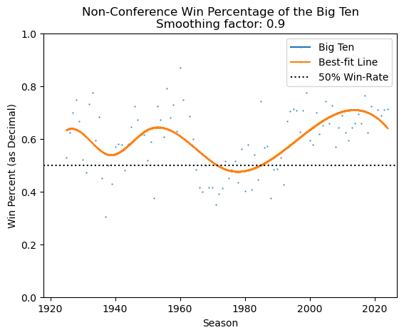
Non-Conference Win-Rate with a Best-Fit Curve
Key Takeaways
Since 1980, the Big 10 has been increasing in strength, but has somewhat plateaued over the last 30 years.
Over the last 30 years, Big Ten has had a non-conference win percentage averaging around 70% despite the trend-line suggesting a dip in the last 10 years

Slide 8
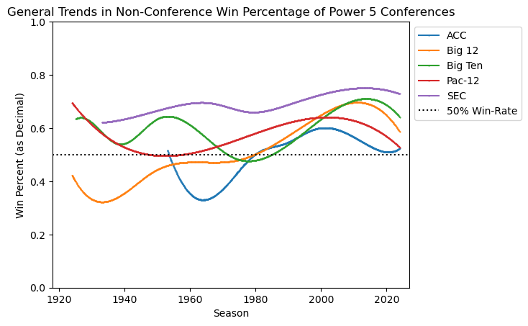
Power 5 Win-Rate (Best-Fit Curve)
Key Takeaways
Power 5 Conferences tend to win more non-conference games than lose.
SEC has consistently been the best conference
ACC has been the worst conference
Power 5 Conferences have been trending stronger over time.

Slide 9
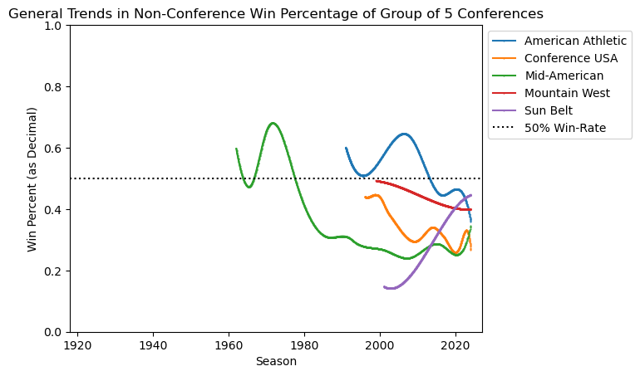
Group of 5 Win-Rate (Best-Fit Curve)
Key Takeaways
The Group of 5 tends to lose more non-conference games than win.
Most conferences are relatively new
All but the Sun Belt have been generally declining in performance.

Slide 10
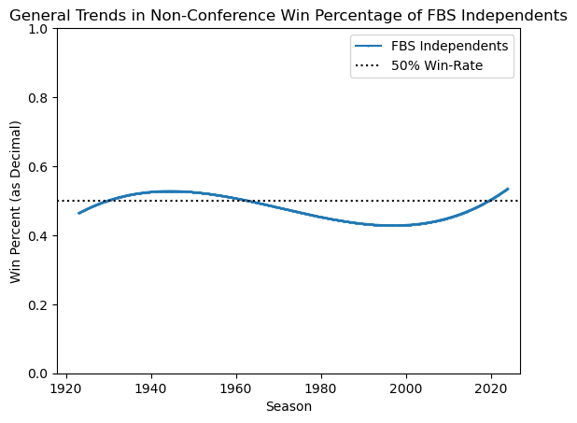
Non-Conference Win-Rate Best-Fit Curve
Key Takeaway
Independents have generally won as many non-conference games they have lost over their whole history
Unlike other conference, they have not seen great changes in their non-conference win percentage.

Slide 11
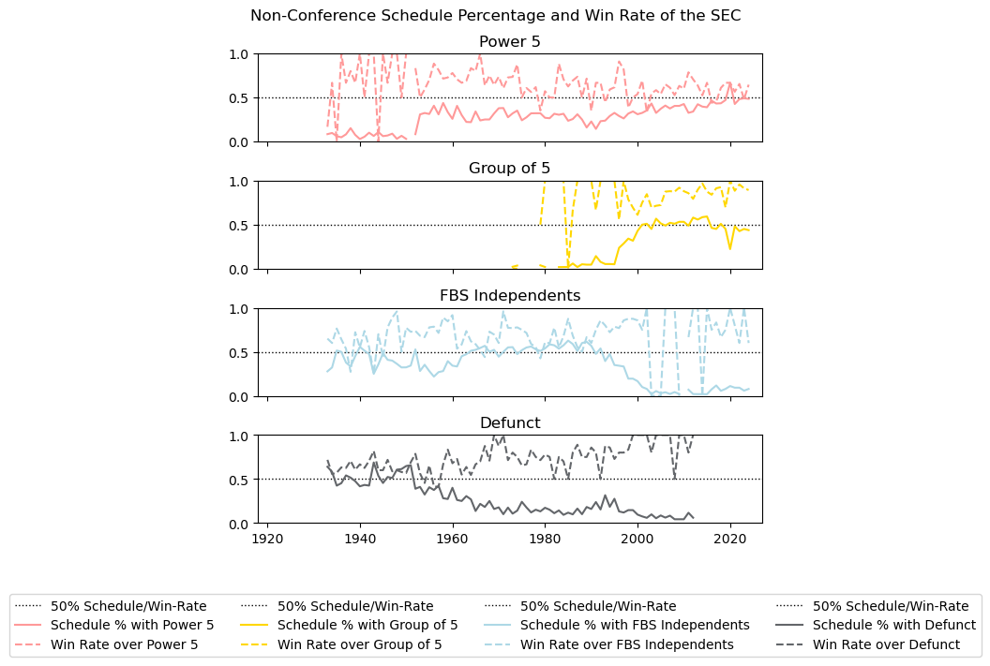
Non-Conference Schedule and Win Rate of SEC
Key Takeaways:
SEC typically wins more games against Power 5 non-conference opponents than loses.
SEC has consistently beaten Group of 5 and Defunct conference opponents.
Since the late 1990s, SEC has started to play Power 5 increasingly more frequently.

Slide 12
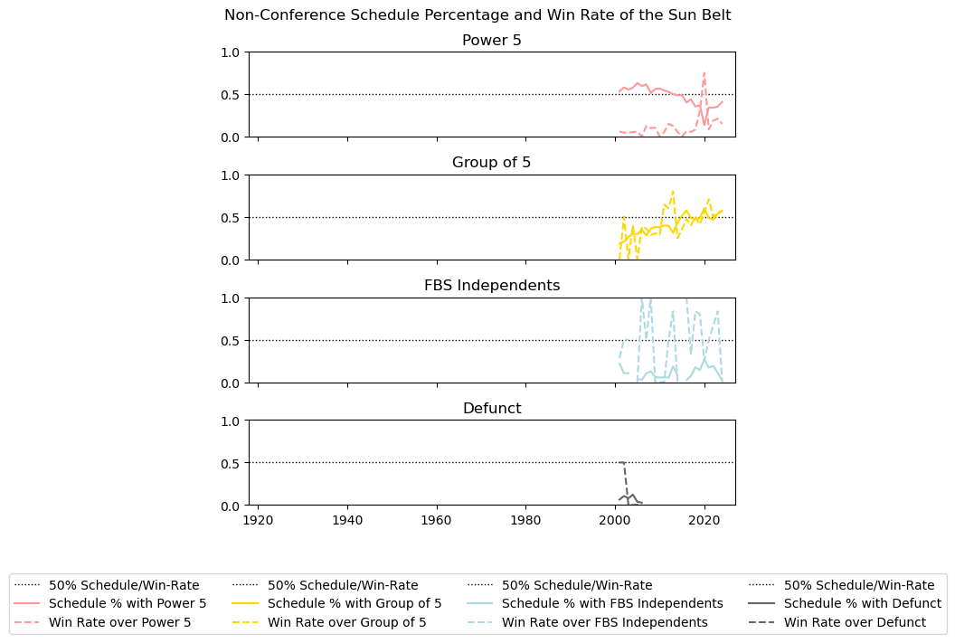
Non-Conference Schedule and Win Rate of Sun Belt
Key Takeaways:
Sun Belt has not done well against Power 5. They are playing them less but seem to be winning a few more.
Sun Belt is a rising star within the Group of 5 by playing them more and winning more.

Slide 13
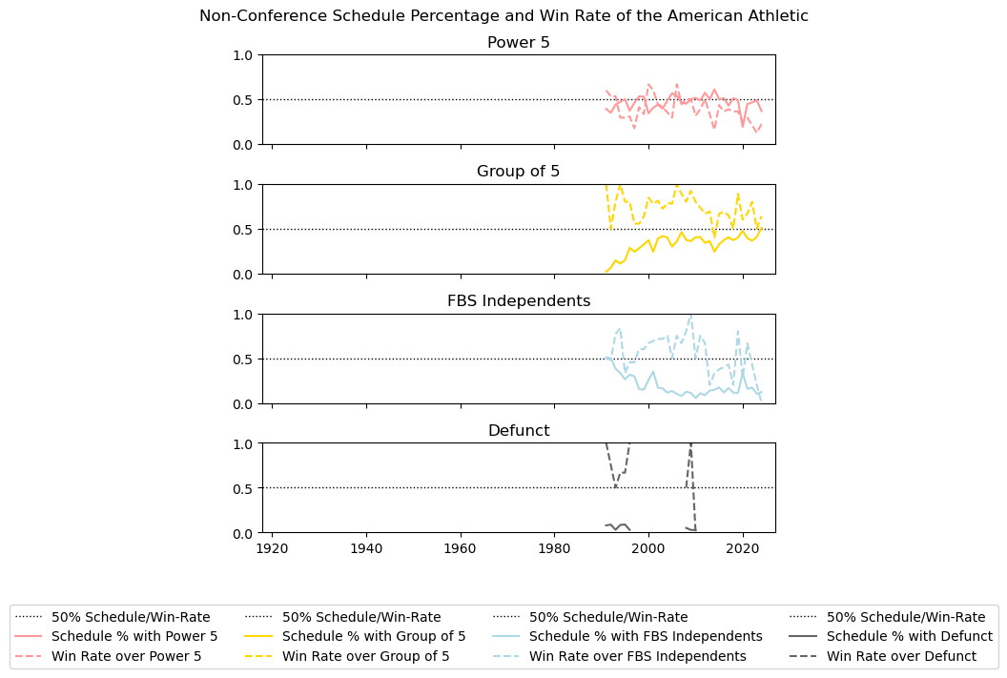
Non-Conference Schedule and Win Rate of AAC
Key Takeaways:
American Athletic has historically looked more like a Power 5 team by beating Group of 5 consistently and having about a 50% win rate against Power 5. However, they seem to be doing worse against both groups now.
American Athletic has played about the same amount of Power 5 opponents as non-Power 5. Although, they may be declining over that last 10 years.

Slide 14
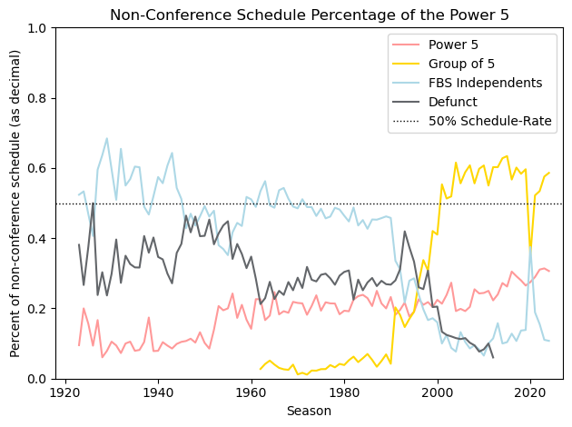
Non-Conference Schedule Percentage of the Power 5
Key Takeaways
Power 5 teams have historically played others rather themselves
Power 5 teams are increasingly playing each other now.

Slide 15
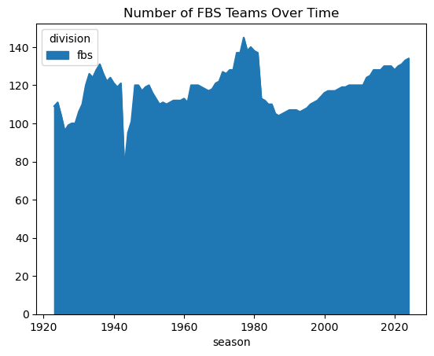
Number of FBS Teams Over Time
Key Takeaway
Since the number of FBS teams is rising back to levels just before Division 1 AA, it could be possible that we will see a potential split again soon.
The valley in the 1940's could likely be due to WW2
The valley in the 1980's could be the introduction of Division 1 AA (today called FCS)

Slide 16
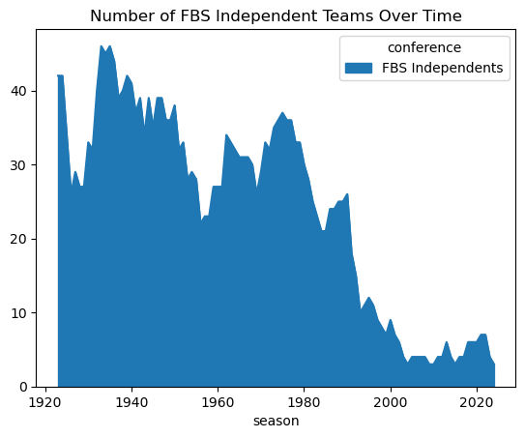
Number of FBS Independents Team Over Time
Key Takeaway
Since the 1980's when the Division 1 AA (today called FCS) was introduced, the number of independents has fallen sharply.
This coincides with Group of 5 conferences beginning.

Slide 17
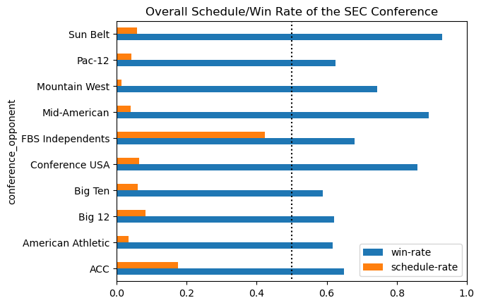
SEC Performance for All Time
Key Takeaways:
SEC typically play ACC
SEC typically wins 60% of the time against its Power 5 opponents
Although SEC typically beats group of 5 teams over 70% of the time, they have only beat American Athletic about 60% of the time
The biggest boost to SEC's win rate has been its frequency of playing with ACC. SEC has an estimated 65% win rate while scheduling twice as much as other conferences.

Slide 18
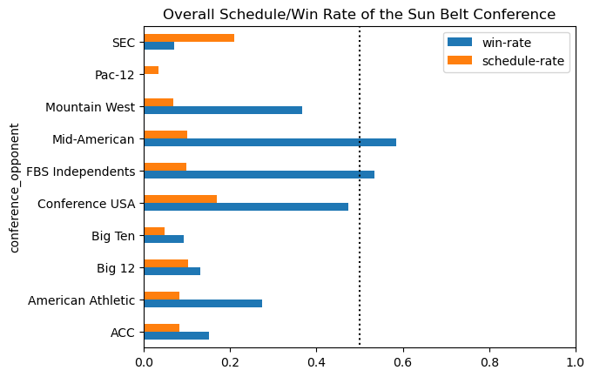
Sun Belt Performance for All Time
Key Takeaways:
Sun Belt plays SEC the most out of the Power 5
Sun Belt plays Conference USA the most out of the Group of 5.
Sun Belt has seen relative success against Mid American ad Conference USA opponents.

